Slide 1
Introduction
CIS 4930 / CIS 5930
Offensive Security
Prof Xiuwen Liu
W. Owen Redwood

Slide 2
This class
Structured as a hands-on survey of topics
Topics hand picked from a variety of expert resources
Hands on through homework assignments
Will transform n00bs into ninjas in 16 weeks
If you get a decent grade
Final project demands you do something impressive:
Make a difference on the security community
Expand existing tools
Design new tools
Explore cutting edge tools / techniques / skills

Slide 3
This class
Week 1: Intro
Week 2: Secure C & Code auditing
Week 3: Intro to Vulnerability Research
Week 4: Reverse Engineering Workshop
Week 5: Fuzzing and Automated Testing
Week 6: Exam #1 / Exploit Development
Week 7: Exploit Development week 2
Week 8: Network Hacking
Week 9: Web Application Hacking Week 1
Week 10: Spring Break
Week 11: Web Application Hacking Week 2
Week 12: Advanced Exploitation 1
Week 12: Advanced Exploitation 2 & Exam #2
Week 13: Penetration Testing & Incident Response Topics Week 1
Week 14: Penetration Testing & Incident Response Topics Week 2
Week 15: Physical Security and Social Engineering
Week 16: Final Exam (takehome)
Taught with a defense-centric focus

Slide 4
This class
Offered previously as “Offensive Security” in spring 2013
CS, Comp Crim, EE, Biomath majors (grad / undergrad)
Made headlines in the security field
During DEFCON :)
Now with more guest lecturers / experts!

Slide 5
The Instructors
Professor Xiuwen Liu (liux@cs.fsu.edu)
specialties: Computer Vision, Pattern Analysis, Computer Security, Cyber Physical Systems Security, etc...
W. Owen Redwood (redwood@cs.fsu.edu)
The primary instructor
specialties: counter intelligence, system administration, exploit development, web application hacking, insider threats, and other bad stuff
don't call me "professor"

Slide 6

#whoami (Owen)
Exploit Developer, Reverse Engineer, Guitarist
PhD Student at FSU, under Mike Burmester
Research area: Counterintelligence tools for critical infrastructure and insider threats
Director of SAIT Research Lab 2010
Founded N0L3ptr CTF team 2011
Now FSU Cybersecurity Club
Sandia National Labs Internship in 2012:
Briefed Obama’s Chief Science Advisor
Invited member of Sandia Summer Institute Think-tank 2012
Created from scratch and taught Offensive Computer Security at the graduate level:
http://offsec.noleptr.com
DISCLAIMER: MY OPINIONS ARE MY OWN AND NOT ANY OF MY EMPLOYERS’

Slide 7
The Website
Hosted at: http://www.cs.fsu.edu/~redwood/OffensiveComputerSecurity/
We will try to video record (screencast) all the lectures and host the links on the website.
Means you can save trees by not printing out all the lecture slides

Slide 8
Grade Breakdown
Homeworks 55%
10 Homeworks are hands on exposure to topics, and are mini-project like
Midterms 30%
Midterms 1 and 2 will cover the meat of the class
Final Exam 15%
Required by FSU. (takehome)
No more term project

Slide 9
Grading Policy
Individual work only:
On every homework, assignment, and project
Do not share answers
In all homeworks I grade based off of your:
Ability to utilize the required skills
Communicate what you did, what happened, and etc...

Slide 10
SAIT Lab Access (room 010)
Most homeworks will not require the lab, and can be done at home in a virtual machine, or by ssh into the lab.
If you have a project idea, and would like to use the lab, contact us for access
We're happy to help!

Slide 11
Midterm 1 and 2
Midterm 1 = Feb 10
Midterm 2 = April 2

Slide 12
Extra Credit
Extra credit will be granted for:
Participation in any capture the flag games
See the FSU CyberSecurity Club to get involved
Weighed upon difficulty of problems solved, and your level of participation
see https://ctftime.org/

Slide 13
What this class is about
Security Assessment
Risk Assessment
RISK = THREAT x VULNERABILITY
"Risk is a function of the likelihood of a given threat-source's exercising a particular potential vulnerability, and the resulting impact of that adverse event on the organization" Source: http://pauldotcom.com/IntroToPenTesting.pdf

Slide 14

This thing we call "Security"
Security is only appreciated when threats are visible, and are stopped

Slide 15
About Security Employees IRL
Only get negative press
attacks make them look bad
good security doesn’t get noticed, is only inconvenient
Often block development work / projects
Aren’t incentivized properly
Only objective is to respond to attacks and manage the attack surface
averse to expanding the attack surface
My opinion:
Should be more involved in testing / fuzzing and evaluated on bugs found as well as security job.

Slide 16
Its time to wake up
http://www.digitalattackmap.com/
But this is just DDoS
We are going to thoroughly explore the art of exploitation
art of gaining unauthorized access
So we can prevent it

Slide 17
Who this class is for
Seniors and Grads who want to become:
Incident Responders
Penetration Testers
Security Professionals
Forensics Professionals
i.e. FBI, law enforcement
Vulnerability Researchers
and so on
We will focus mainly on penetration testing and incident response

Slide 18

Who this class is NOT for
Students who have not taken a security class before
you will fail this class
Lazy people who don't do the assigned reading or homework.
I don't care if you don't do it for other classes. You better do it for this one.
Tests will cover reading material not covered in class
FAIL

Slide 19
The books
Hacking: The Art of Exploitation 2nd edition- Jon Erickson
2008 book (will be relevant for a very long time)
HANDS ON approach to all the material, rich with source code, comes with CD
Is going to be our main textbook
The Web Application Hacker’s Handbook 2nd edition- Dafydd Stuttard
2012 book
2nd half of the class

Slide 20
Virtual Machines
The Live CD that comes with Hacking the Art Of Exploitation is ideal for experimentation.
Set up a VM (I suggest Virtual Box) with .iso of the live cd.
You will use this VM to do many of the homeworks

Slide 21
The books used to create this class
An incomplete list:
Hacking: The Art of Exploitation
Counter Hack Reloaded
The Web Application Hacker’s Handbook
The Shellcoder's Handbook (2nd ed)
Windows Internals 6 (1 & 2)
Metasploit: The Penetration Testers Guide
Practical Malware Analysis
The Art of Debugging with GDB, DDD, and Eclipse
The Rootkit ARSENAL
Secure Coding in C and C++
Exploratory Software Testing
Writing Security Tools & Exploits

Slide 22
Motivations
Teaching only defense is like teaching people only to play goalie in soccer when you don't even know what the goal looks like.
people will be taking shots at you all day, and if you don't know how to attack, you won't know what to expect.
"One test is worth a thousand expert opinions" - Anonymous dude
Penetration testing is the best way to assess correct implementation of security controls and policies
And required for regulations Compliance (i.e. PCI...)

Slide 23
Motivations
Most security education focuses heavily on Cryptography...
but...
"One of the most dangerous aspects of cryptology ..., is that you can almost measure it." -Matt Blaze (Afterword in Bruce Schneier's "Applied Cryptography")
But to break into most systems, you don't have to break crypto.

Slide 24
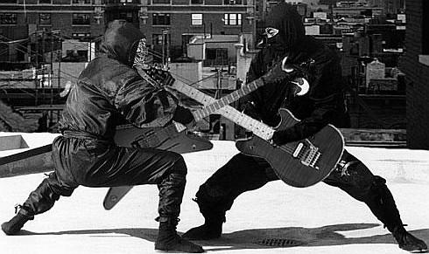
Motivations (Pen testing)
Pen testing is fun
you get paid to hack
and think like a bad guy
And people look at you like ^

Slide 25
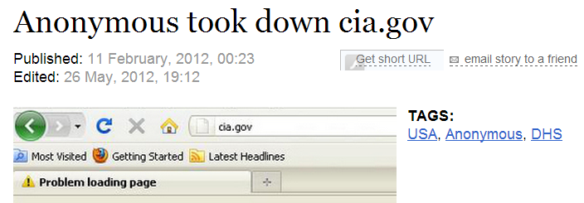
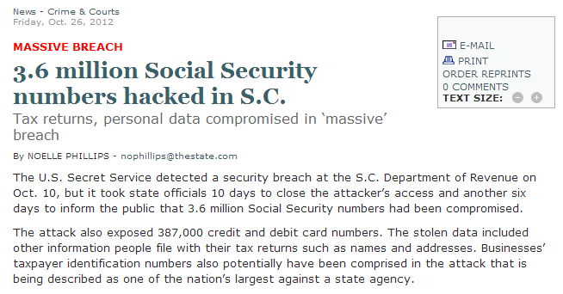

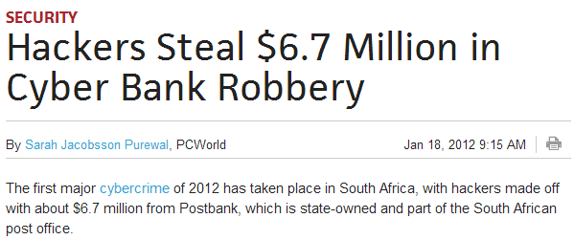
Motivations (Incident Response)
Networks get hacked
Incident responders are in HIGH DEMAND

Slide 26

Pen Testing & Incident Response
Both require a great deal of offensive knowledge
"Dark Arts"
But Pen Testing = proactive (hopefully)
and Incident Response = reactive

Slide 27

Hacking versus Penetration Testing
Hacking, AKA cracking, etc..
Penetration Testing, AKA red teaming, security assessment, etc..
What's the difference?
?

Slide 28
PERMISSION
really thats it.
Without permission, its ILLEGAL

Slide 29
Lets talk Vulnerabilities

Slide 30
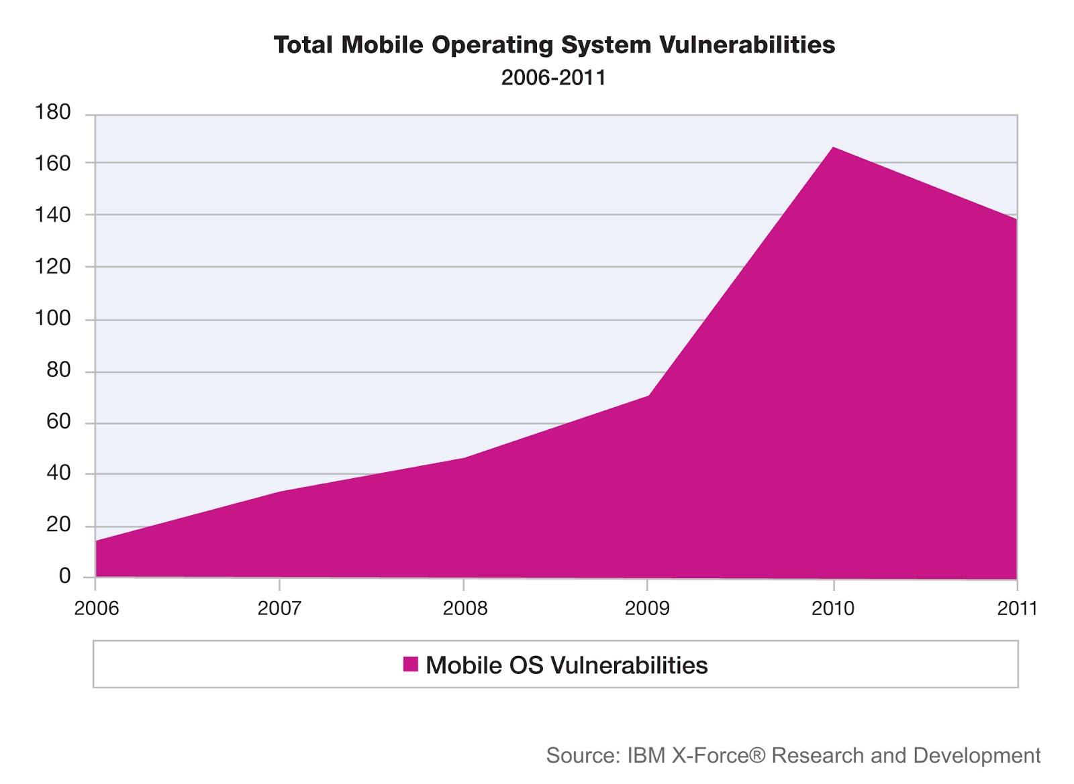
Vulnerabilities (Mobile)

Slide 31
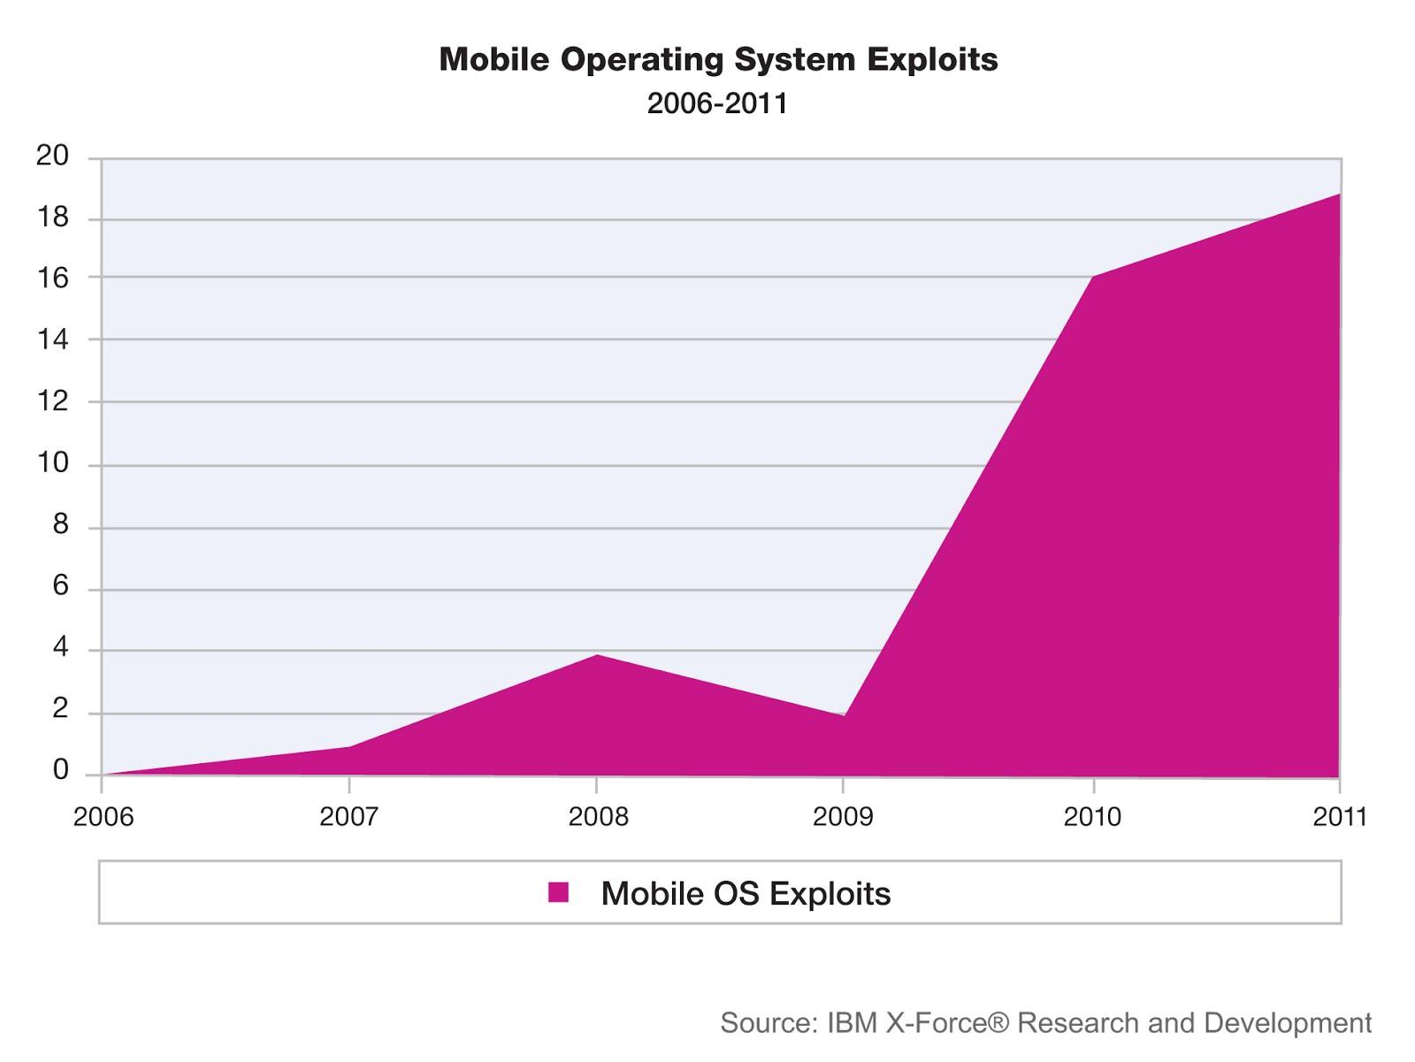
Exploits (Mobile)

Slide 32
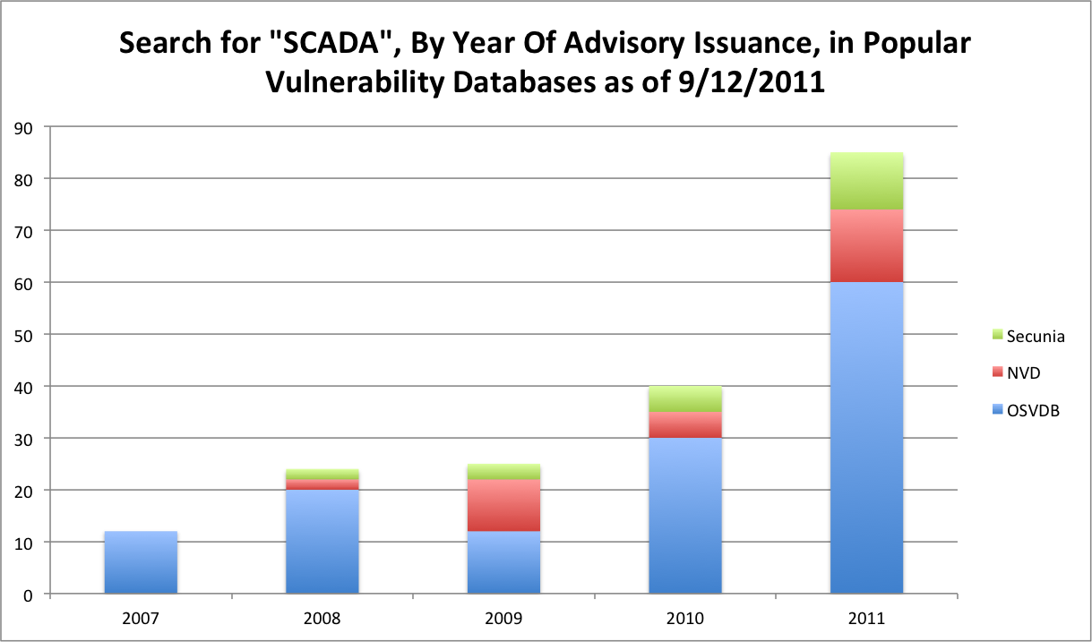
Vulnerabilities (SCADA)
Source: http://www.energysec.org/blog/quick-and-dirty-vulnerability-trending/

Slide 33
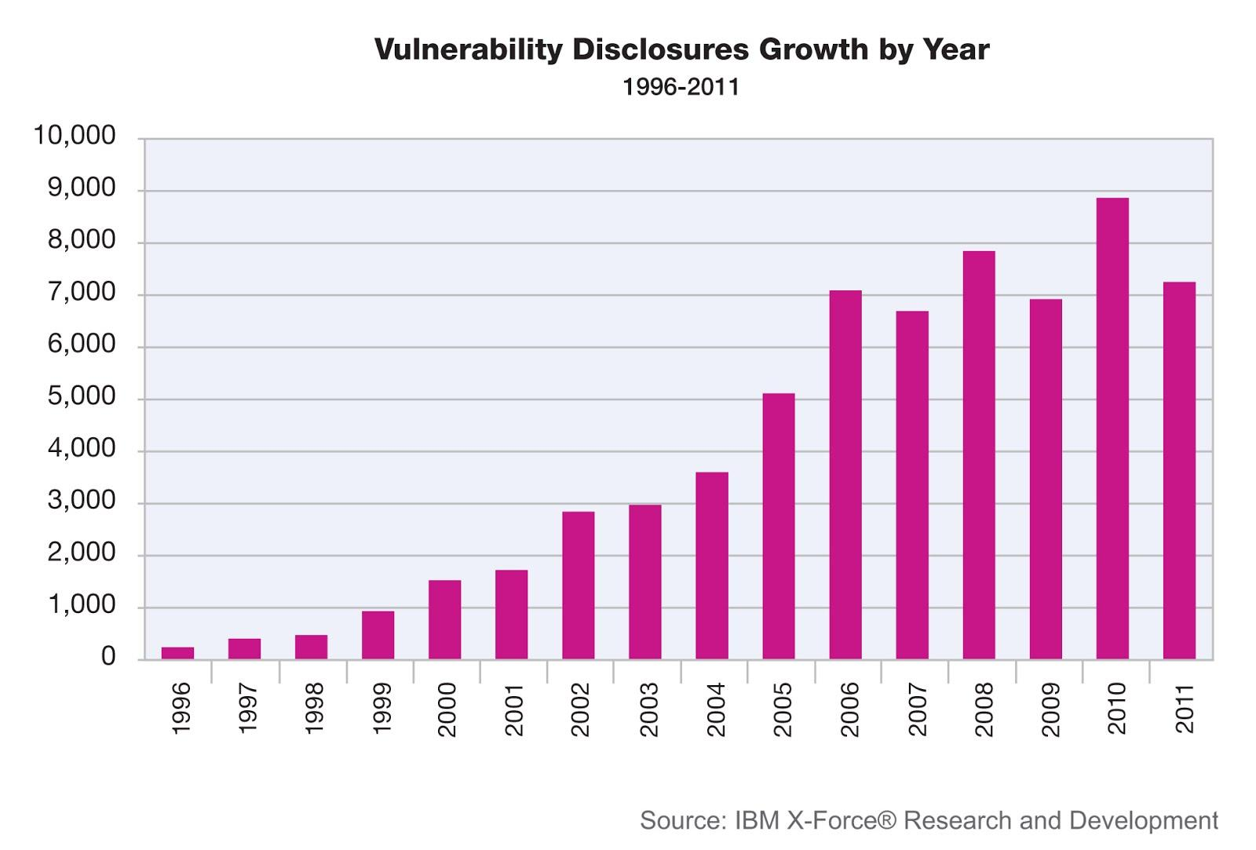
Total Vulnerabilities Disclosed

Slide 34
Ethics and Vulnerability Disclosure
Say you find a security problem
Who do you tell? And how?
How would they react?
Would they sue you? patch it? or ignore it?
What if you worked hard to find it?
should you be rewarded?
What if they threaten legal action?!?!?!

Slide 35

How We Got Here

Slide 36
History time! Early on...
Security mailing lists
Phrack
1985
attacker focused
99% of people didn't know about security
wasn't a real problem
Perception: vulnerability "Researchers" were evil people, practicing dark magic

Slide 37
Private Communities
Morris worm (1988)
Woke people up
invite only mailing lists rose
these also became targets
Main problems:
Vendors would not acknowledge security problems
"Buy at your own risk"
but mostly only the attackers knew the risks...
But this changed...

Slide 38
Full Disclosure
Inform everyone, good and bad!
8lgm (8 legged groove machine)
Basic format, remains today:
Affected software & OS's
Description of Impact
Fix and workaround info
Reported to vendor and to the public
Extremely controversial at time!
But in a sense necessary

Slide 39
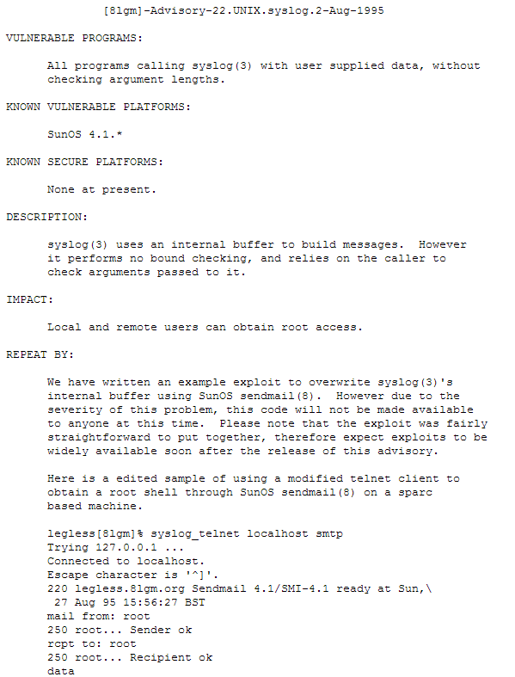

Slide 40
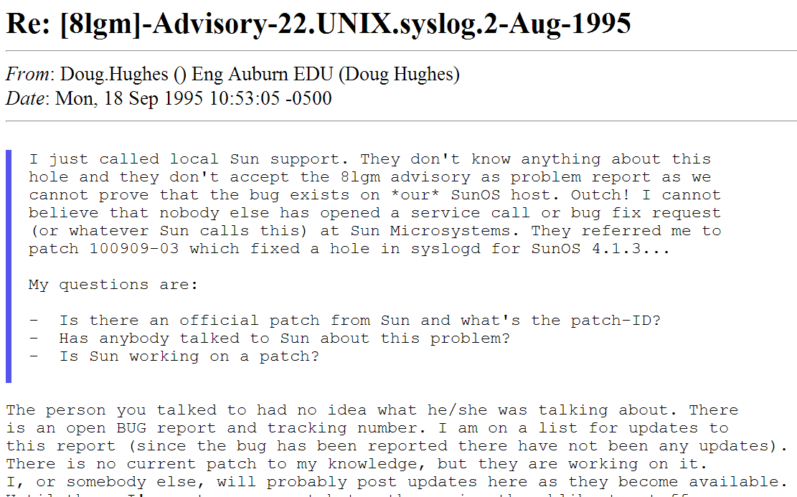
Full Disclosure common outcome...

Slide 41
Situational awareness was bad....
Poor communication on the inside of vendors
led to confusion/panic in customers
lawyers involved
slow patching / solutions
sometimes attackers could exploit it quicker
Still a problem with small startups and small companies

Slide 42
Full Disclosure continues
The main problems:
Creates a problem to force vendors to act
Lack of clarity around vuln research and legal issues
Vendor's first reaction was to get lawyers involved
Underground industry evolved around all the new available info
mass malware rises from full disclosures
script kiddies got more skills
Bottom lines:
"Researchers" became famous from it (why stop?!?)
FD did not result in a reduction of attacks...

Slide 43
Responsible Disclosure ~2002
Mass Malware & Worms made people reconsider FD in 2000's.
ILOVEYOU, Code Red, Code Red II, Nimda, Blaster, Slammer, etc...
Most worms reused FD researchers' code
"Responsible Vulnerability Disclosure Process"
Submitted to IETF by Christey & Wysopal in 2002
Responsible - researchers withhold info until vendor patch
Responsibilities centered around researchers, not vendors (problem???)
Source:http://tools.ietf.org/html/draft-christey-wysopal-vuln-disclosure-00

Slide 44
Current Status of Industry
Coordinated Vulnerability Disclosure
"We swear we won't sue you"
Vendor accepts responsibility for security issues :D
vendorsec Mailing Lists
Invite-only mailing list for sharing vulnerability details and research (Bad idea??)
Compromised in 2011
Delayed Disclosure
Issue PR release (vuln found in XYZ!)
Delay to disclose vuln details at major conference (Black Hat, Defcon, etc..)... patch may not be out!

Slide 45
Bug Bounties ~2010
People came to realize:
Vulnerability research is a valuable service that protects vendors and customers, and it should be rewarded.
Linus's Law: "given enough eyeballs, all bugs are shallow" (Linus Torvalds)
Thus bug bounties were formed
Bugs for $$$$$!

Slide 46
Bug Bounties
Company | Scope | Bounty | URL
Google | Web & Apps | $500-$20,000 | http://www.google.com/about/appsecurity/reward-program/
Facebook | Web | $500 + | https://www.facebook.com/whitehat/bounty/
Mozilla | Web / Mobile/ Apps | $500 - $3,000 | http://www.mozilla.org/security/bug-bounty.html
Barracuda | Appliances | up to $3,133.70 | http://www.barracudalabs.com/bugbounty/
Zero Day Initiative | Popular software / applications | Reward points, benefits, and $500-$5,000 | http://www.zerodayinitiative.com/about/

Slide 47
Bug Bounties
Company | Scope | Bounty | URL
tarsnap | Web & Apps | $1-$2,000 | http://www.tarsnap.com/bugbounty.html
Wordpress | Web | $100-$1,000 | http://www.whitefirdesign.com/about/wordpress-security-bug-bounty-program.html
Hexrays | Software | $5,000 | http://www.hex-rays.com/bugbounty.shtml
Paypall | Web / Apps | unknown | https://cms.paypal.com/cgi-bin/marketingweb?cmd=_render-content&content_ID=security/reporting_security_issues
And many more.....

Slide 48
Bug Bounties and Disclosure Websites
Huge list here:
http://computersecuritywithethicalhacking.blogspot.com/2012/09/web-product-vulnerabilty-bug-bounty.html

Slide 49
Timeline
Bug Bounties
(~2010-present)
Full disclosure
(~1993-2002)
No disclosure
(~1950-1988)
Private Communities / Mailing lists
(~1988-1993)
Responsible disclosure
(~2002-2010)

Slide 50
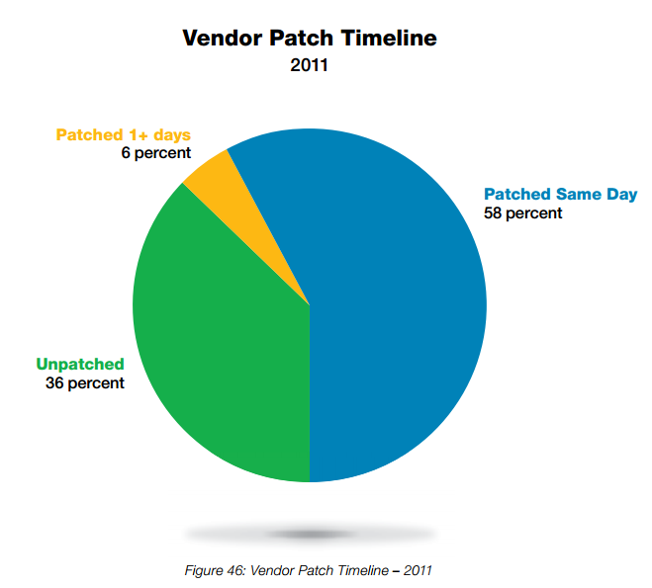
Vendor's Patching Trends got better
Source: IBM's X-Force 2011 Trend and Risk report

Slide 51
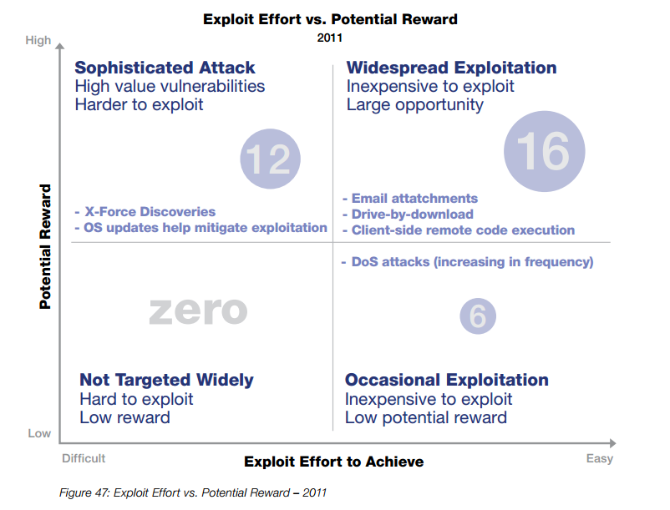
Bad Guy Trends
The usual case for attackers
DDoS, groups like Anon...
Source: IBM's X-Force 2011 Trend and Risk report

Slide 52
Total Vulnerabilities Disclosed

Slide 53
Are things getting worse?
More and more vulnerabilities!!!
No
Situational Awareness is getting better

Slide 54
Disclosure Debate
Still people are all about:
Anti-disclosure
Full-disclosure
Responsible-disclosure
Coordinated-disclosure
Delayed-disclosure
etc...

Slide 55
How NOT to do disclosure:
Video from the hacker who was behind the July 2013 Intrusion on Apple Developer's sites.
http://www.youtube.com/watch?v=q000_EOWy80
Shows ACTUAL user's personally identifiable information (PII) in his video
"I am being accused of hacking but I have not given any harm to the system and i did notwanted to damage."
Likely a troll

Slide 56
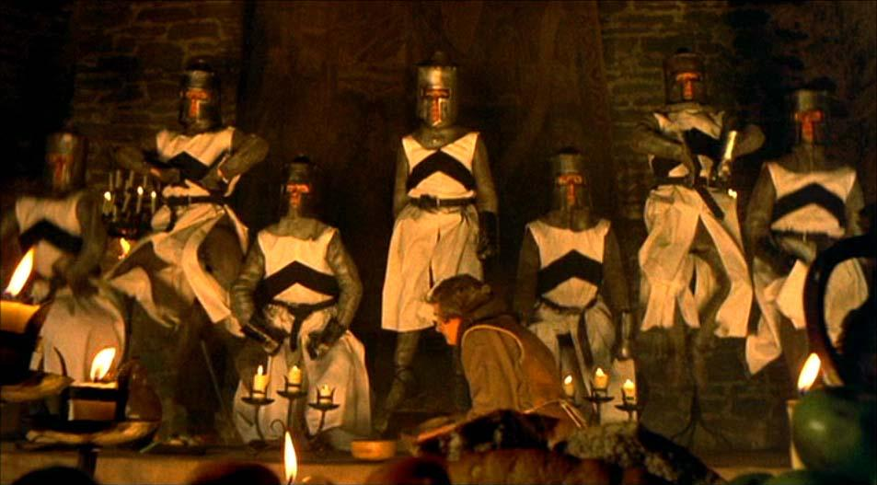
On second thought, lets get back to..

Slide 57
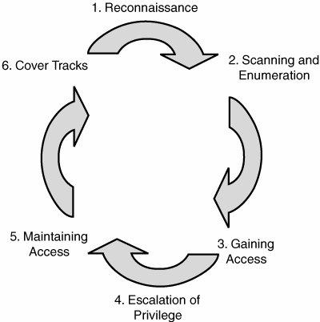
The Basics of Penetration Testing and Hacking
The methodology cycle of hackers, and penetration testers.

Slide 58
Prior to a penetration test...
getting permission
A discussion with the client establishes the following:
The type of penetration test
physical access or just remote access?
social engineering allowed?
covert or overt
Rules of Engagement
What is off limits
Threat model (insider threat, ex-employee, outsider, etc)
Specified targets
Timeline
What to expect from the report

Slide 59
1) Reconnaissance
Internet searches
For URLs (google, yahoo, bing, etc)
For devices / access points (http://www.shodanhq.com/)
Company website
cached versions
of public records
social media
Phone calls
to sales
to IT
to PR
Visit in person...

Slide 60
This = Intelligence Gathering
Identifying target and it's assets, and services, and gathering as much info as possible.
Company Website, google
Public Financial records / news
Recent / future mergers
DNS records
Social Media, employee blogs
phone calls, visits
http://www.pentest-standard.org/index.php/Intelligence_Gathering
OSINT
(open source intelligence)
HUMINT, usually off limits

Slide 61
2) Scanning and Enumeration
This involves determining what applications/OSes are up and running, what versions they are, discovering accounts for them, and how to access the applications.
TONS of tools for automating this.
nmap
w3af
sqlmap
metasploit
many many more

Slide 62
Identifying Attack Surface
Depends on the entity (system, business, etc), and the components
For a single system: would be all ports running open, all user accounts and the strengths of their passwords, the filesystem permission model, all available programs (i.e. /bin/cp, /bin/ls, /bin/sh, /bin/bash), and anything excluding physical access.

Slide 63
Discovering Vulnerabilities
Perhaps a vulnerable CMS is used, or plugin?
plugins are attacked far more than the framework
Perhaps an old network service is in use?
Default credentials work anywhere?
routers, SCADA, PLC
etc...

Slide 64
3) Gaining access
Via:
Brute force
web hacking
exploit development
malware / mass-malware
Social Engineering
etc...

Slide 65
Common ways attackers break into businesses
Social Engineering (HUMINT)
easiest way in BY FAR
spear phishing: trick an employee to visit your malicious link, or execute your malicious attachment, or give over user/pass
Web application exploitation
command injection: SQLi, CGI,
directory traversal: ....home.php?../../../../etc/passwd
Pivoting from 3rd party partner systems
Network application exploitation
Malicious USB's, or gift gaming keyboards.
and more

Slide 66
4) Privilege Escalation
Gaining access is just one step.
Attackers want root.
Password cracking
SUID program exploits
sandbox escape
keylogging
More social engineering
etc...

Slide 67
5) Maintaining Access & Post Exploitation
After attackers get root access to your systems:
establish back doors (prefer open source applications, for ease)
crack moar passwords, expand control
erase logs
go after your IP, data, and users
steal $$$
pivot into 3rd party systems

Slide 68
What you will learn in this class
Reverse engineering (x86) of binaries
Exploit Development
Shellcode development
Network hacking
Web Application Hacking
SQLi, XSS
Social Engineering
Metasploit
Post Exploitation techniques
Lockpicking (Physical security is important too!!!) and more

Slide 69
The most important thing you will learn
How to communicate system vulnerabilities to others. So that they can fix them!
Hackers who cannot communicate are....
WORTHLESS

Slide 70
Threat models
3 general model types
Attacker centric
starts with an attacker and evaluates their goals and how they might achieve them
Software centric
starts with the design of the system, and attempts to step through a model of it... looking for attacks against each aspect of it
i.e. Microsoft's Security Development Lifecycle
Asset-centric
starts from the assets in a trusted system.

Slide 71
Categorizing Threat
The key is understanding the capabilities posed by threats.
The number of threats is continually increasing.

Slide 72
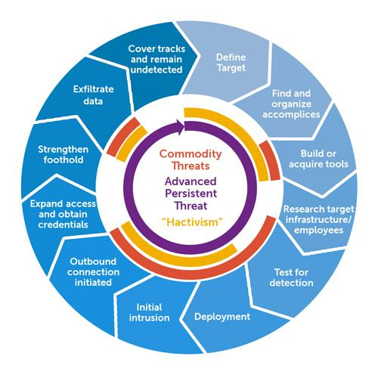
from wikipedia

Slide 73
But why
RISK = THREAT x VULNERABILITY
it is important to express the threat model when discussing vulnerabilities to help assess risks

Slide 74
Bad guy goals
On the rise :(
$$$
Critical Infrastructure (i.e. proj Night Dragon)
PII, enemies, political dissidents (operation Aurora)
credit cards, financial data (Sony ps3 hack)
passwords, password hashes (every hack)
TOTAL Corporate Sabotage (HBGary hack)
partner companies / 3rd parties (too many)
they will pivot from your systems to attack partners
LONG TERM backdoors into your system
intellectual property (most APT hacks)
and anything for the lulz

Slide 75
The methodology cycle of hackers, and penetration testers.

Slide 76
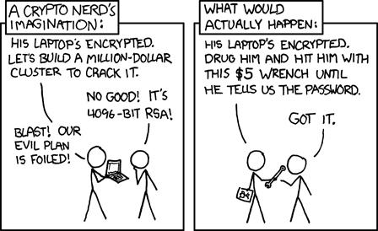
Real World
Bad guys have major advantage. They can:
use proxies, spoof IP, MAC address
attack anonymously
utilize android/windows spyware apps
attacking your partners
blackmail/$5 wrench
easily buy crimekits
zeus tr0jan
can break many laws
impersonate police
social engineering

Slide 77
Real World...
Thats why pen testing and incident responders are so important

Slide 78
Doubts?
Can't we just fix this crap by:
everyone being smart (no more dumb users)
everyone using strong passwords
safe code
(no unsafe C functions)
safer languages like python
fix all the buffer overflows, SQLi vulns, etc!! Come on already its 2014!!!
keeping everything patched?
etc...
I really wish, but its not likely!
:(

Slide 79
Questions?
Reading: 0x200 up to 0x260 (HAOE)

Slide 80
Sources
All the history slides:
Dan Guido "Vulnerability Disclosure: Penetration Testing and Vulnerability Analysis", Fall 2011. pentest.cryptocity.net/files/intro/vuln_disclosure.pdf

